Slide 1
Directions to UPMC Mercy and Conference Room

Slide 2
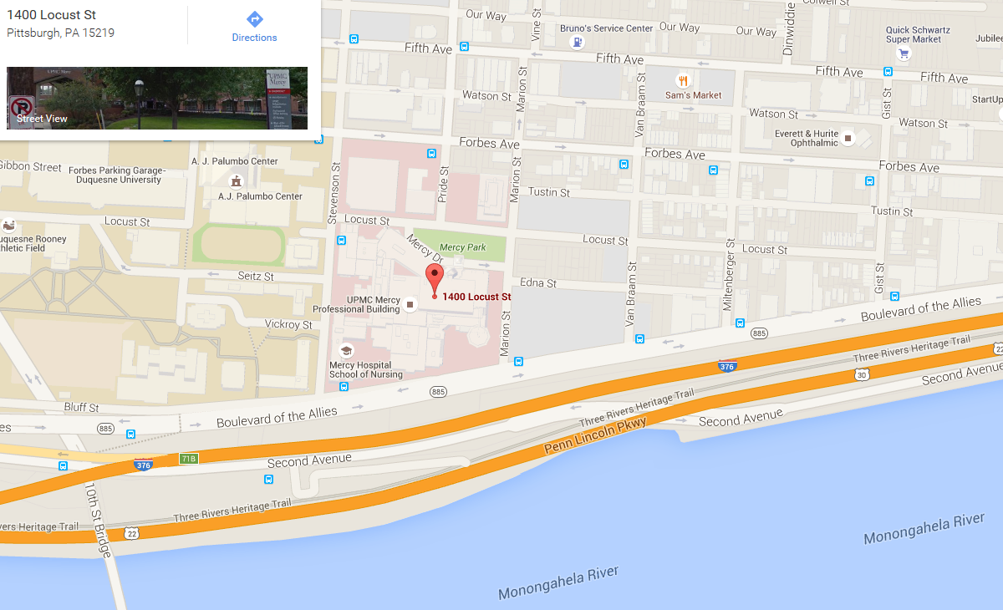
UPMC Mercy Hospital address: 1400 Locust Street, Pittsburgh 15219
Link to google directions: https://www.google.com/maps/search/1400+Locust+St.,Pittsburgh,PA+15219/data=!4m2!2m1!4b1
You will enter garage on corner of Locust Street and Stevenson Street

Slide 3
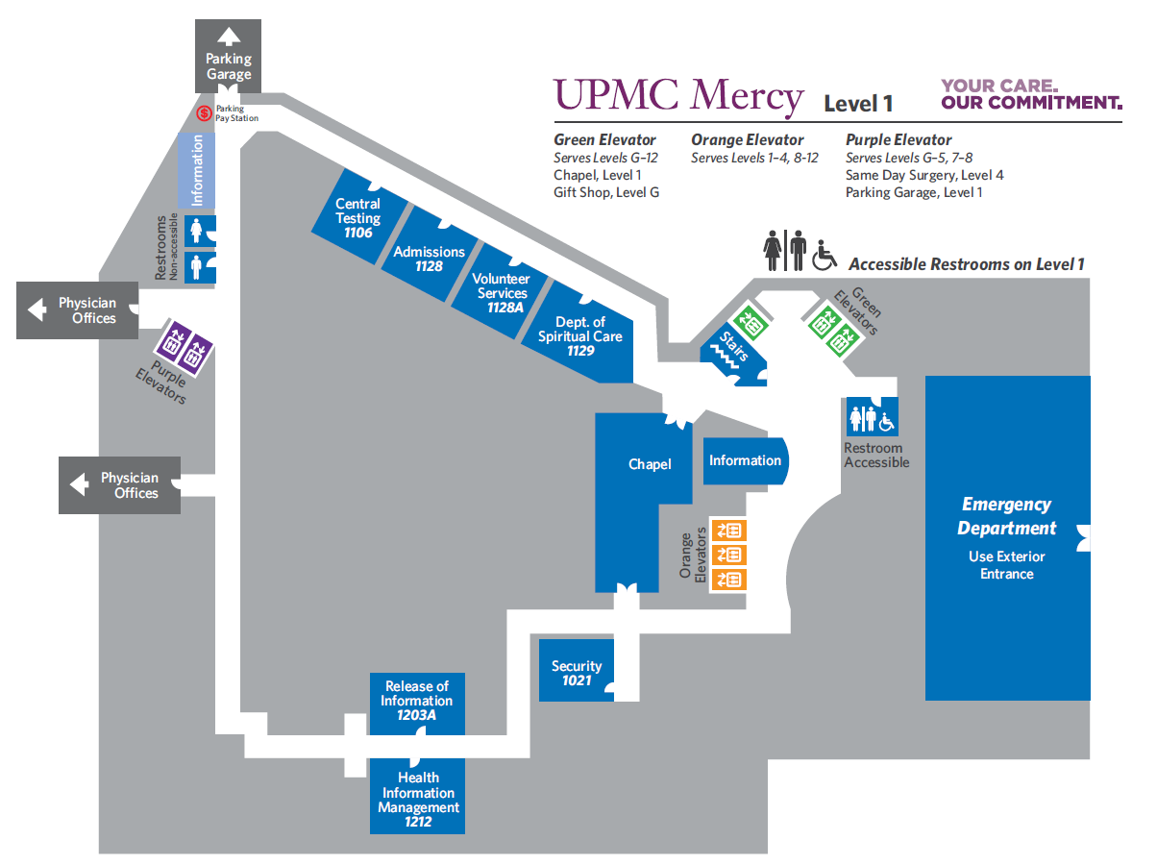
Park in parking garage located on Locust street across from hospital
Take garage elevator to Level D which will bring you to the walkover bridge
This brings you to level 1 of the hospital
Go straight ahead to the Purple elevators
Take Purple elevators to level 2

Slide 4
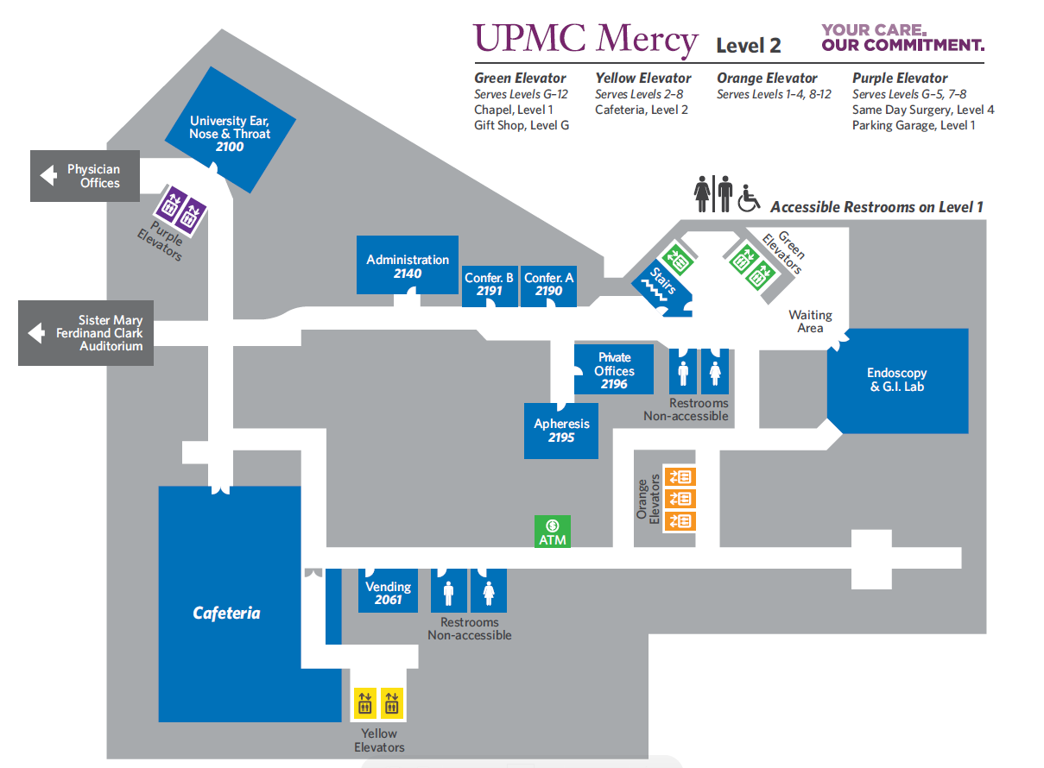
Head to the right when you get off the elevator
Follow hallway and take first left, you will notice this hallway is carpeted
Continue straight down carpeted hallway until you see conference room 2191/2190 on the left. There are two doors and numbers, but it is one large room.

